Slide 1
Depth of Field Prediction
Ζούρος Μιχάλης

Slide 2
Problem to Solve
Image classification to Deep and Shallow Depth of Field images from RAW images
Implementation in Python3 with the use of various libraries (OpenCV, Numpy, Matplotlib/Seaborn, Sklearn/Keras)
Github: https://github.com/mzouros/ml_dof

Slide 3
Data Collection
Toy Dataset from personal portofolio
Main Dataset downloaded from https://github.com/sniafas/photography-style-analysis/tree/main/dataset (over 25k images)
Many thanks to @tygiannak and @sniafas for the data supply

Slide 4
Data Preparation & Pre-processing
Handcrafted preparation of the Training/Test datasets
500 images labeled as Deep(0) or Shallow(1) DoF
80/20 ratio (Training: 400 / Test: 100)
Input dataset (RAW images)
Image Standardization - resize images to 200x200

Slide 5
Data Exploration
Changing Colorspaces (GBR, RGB, Grayscale)
Geometric Transformations (Scale, Rotate)
Smoothing (Blur, GaussianBlur)
Thresholding
Edge Detection
Morphological Transformations (Open, Gradient)
Histograms (RGB, Grayscale, Edges)
Gradients (Sobel, Laplacian)

Slide 6
Feature Extraction
For kNN, SVC:
Load images as 16-bit
Remove noise by blurring with a Gaussian filter
Convert the image to grayscale
Apply Laplace function
Convert images back to 8-bit
The output of this process is a features vector
For CNN there is no need for Feature Extraction

Slide 7
Data Revision & Augmentation
Consider image size
from 100x100 back to original size (200x200)
Consider more data
Augment dataset via Image Transformation (Rotation)
from 200 images to 500

Slide 8
Classification
Fit Models:
kNN
SVC
CNN
Train / Test Accuracy Difference
Metrics:
Accuracy
Recall
Precision
F1 Score
Confusion Matrix
Average & Standard Deviation of all Metrics (kNN)
Precision / Recall and ROC Curves (SVC)

Slide 9
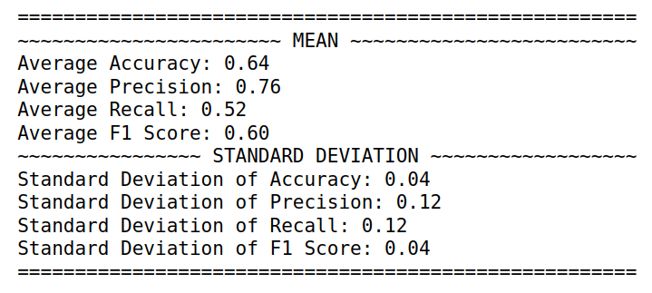
Results - kNN
Algorithm = auto (same results for all)
k = range(1, 15)

Slide 10
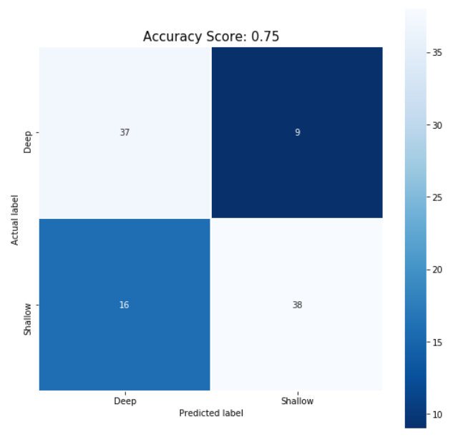
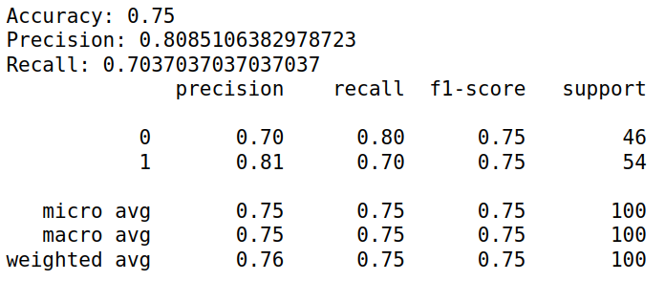
Results - SVC
kernel = ‘rbf’
C = 2, gamma = ‘scale’

Slide 11
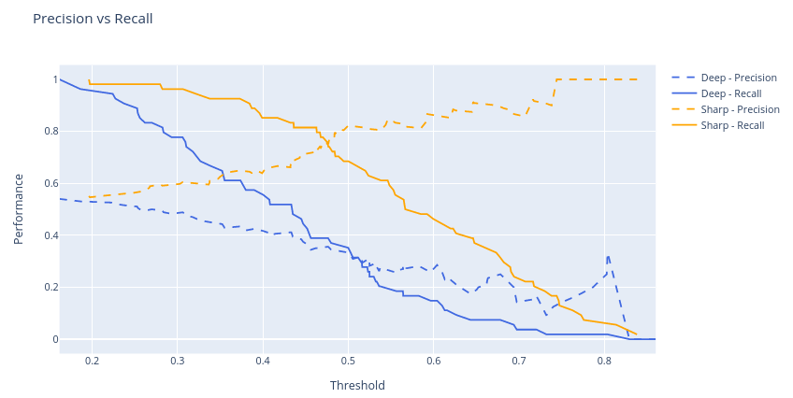
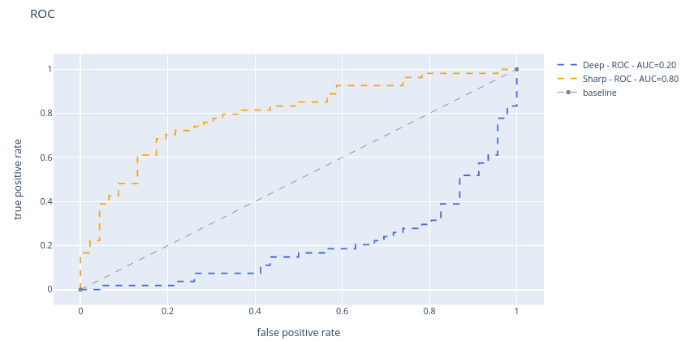
Precision/Recall & ROC Curves

Slide 12
Discussion
Problems during implementation:
DoF is a concept closely related to the 3D world and trying to identify it inside a 2D image with traditional ML methods proved challenging
DoF estimation (for labeling) in 200x200 size images was eye-hurting
OpenCV library's default colorspace is BGR. Extra transformations needed to plot
Bias -> shallows are humans/animals/plants, deeps are landscapes and many are from top down angle
White background TOP DOWNs and deep DoF images which include sky and/or sea reflection were becoming a noise for our Deep dataset after the Laplacian Filter

Slide 13
Future Work
Different libraries like Mahotas, which provides more advanced features such as haralick, local binary patterns, etc
Different algorithms, like Decision Trees (..but, CNN FTW)
RGB, HSV instead of Grayscale
Bigger Dataset (1000+ images)
Bigger image size (maybe 600x600)
SMOTE for Dataset’s balancing

Slide 14
References
https://towardsdatascience.com/from-raw-images-to-real-time-predictions-with-deep-learning-ddbbda1be0e4
https://medium.com/swlh/image-classification-using-machine-learning-and-deep-learning-2b18bfe4693f
https://github.com/hasabo/Machine-Learning/blob/master/Python/Image_Classification%20/Image_Classification.ipynb
https://www.analyticsvidhya.com/blog/2019/08/3-techniques-extract-features-from-image-data-machine-learning-python/
https://freecontent.manning.com/the-computer-vision-pipeline-part-4-feature-extraction/

Slide 15
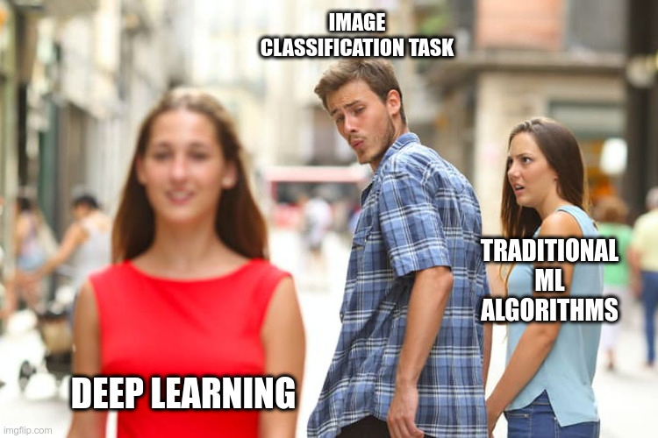
Thank you!

